Slide 1


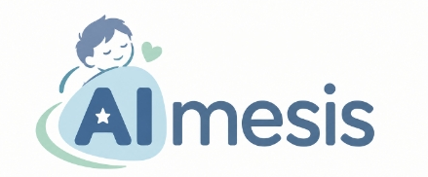

Hacking for Good | Solve with Google 2026
AI-powered care in pediatric CINV-control
Katleen Balliauw & Anthe De Pauw
Hospital Pharmacists
University Hospital Antwerp

Slide 2
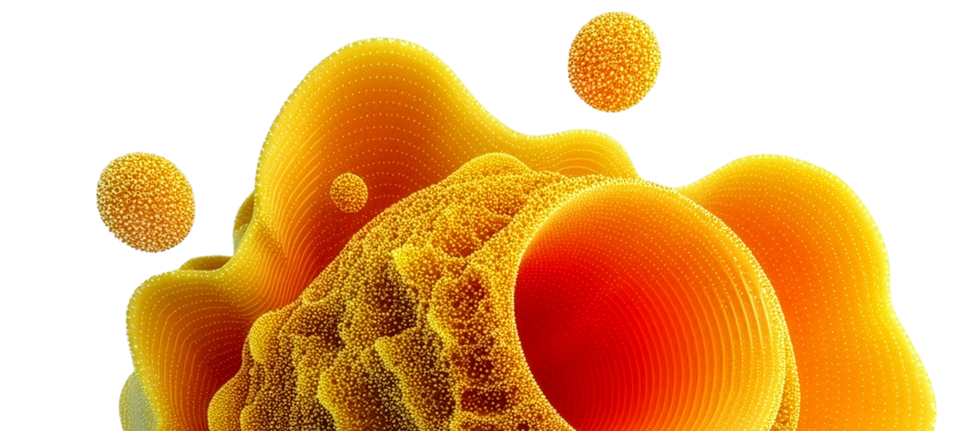

The problem
Clinical burden on children
Chemotherapy-induced nausea and vomiting (CINV) is one of the most distressing side effects of chemotherapy in children with cancer. So every child that is facing chemotherapy, should have their therapy assessed for emetogenicity. Balancing the choice and use of antiemetics against the chance of chemotherapy causing nausea and vomiting is the key principle
Manual Protocols
Selecting the optimal antiemetic strategy is often complex. You have to determine emetogenicity of your chemotherapeutic agents and evaluate multidrug emetic risk. When choosing your antiemetics, you have to cross-reference static PDF hospital guidelines and take into account contra indications, patient-specific factors and potential drug interactions.

Slide 3
Vision
The Hackathon Vision
To develop a system that automatically determines and predicts the emetogenicity of a prescribed chemotherapeutic agent/combination therapy, links it to local hospital guidelines and instantly generates a personalized antiemetic recommendation
Transform static hospital CINV control guidelines into an intelligent clinical decision support system (CDSS) that automates risk stratification and enforces zero-hallucination proposal for prescribing
The tool should also consider contra indications and patiënt specific characteristics, such as:
  -Administration route IV, PO
-available pharmaceutical formulations
-the child’s ability to take medication (e.g. swallow tablets, sirup, nasogastric tube,etc.)
-The child’s own preferences.
It screens for nausea and vomiting history of the child.
It generates an individualized “nausea and vomiting passport” based on their history of nausea and vomiting during previous therapies, which can be used to propose an appropriate antiemetic prescription for subsequent treatments
Localization based on patience preferred language
(Bonus point) Development of a companion App to collect history of nausea and vomiting. (e.g. by every instance of nausea the parent can press a button and it’s recorded)

Slide 4
Hospital Protocol Baseline • July 2026 Versie 2
The Grounding Baseline
Introducing the hospital's July 2026 Anti-emetica beleid CINV policy (HEC, MEC, LEC, Minimal tiers)
Core Protocol Principle: The single highest-risk chemotherapy agent dictates the baseline prophylaxis tier. Anti-emetics start 30 min (IV) or 60 min (PO) pre-chemo. Dexamethasone is strictly excluded in Acute Lymphoblastic Leukemia (ALL) and brain tumors.
Hoog Emetogeen (HEC)
>90% Risk
Matig Emetogeen (MEC)
30–90% Risk
Chemotherapy: Cisplatine, Carboplatine, Melphalan IV, Thiotepa IV ≥ 300 mg/m², Cyclofosfamide > 1500 mg/m², Cytarabine IV ≥ 3 g/m², Ifosfamide/Etoposide.
Quadruple Therapy: Ondansetron (3x/day) + Dexamethasone + Aprepitant + Olanzapine (>2 years).
Chemotherapy: Ifosfamide, Daunorubicine, Cyclofosfamide IV ≤ 1500 mg/m², Cytarabine > 200 mg - < 3 g/m², Methotrexaat IV ≥ 250 mg - < 12 g/m², Irinotecan.
Dual Therapy: Ondansetron (2x/day) + Dexamethasone OR Aprepitant.
Laag Emetogeen (LEC)
10–30% Risk
Minimaal Emetogeen
<10% Risk
Chemotherapy: Vincristine, Etoposide, Cytarabine < 200 mg/m², Methotrexaat < 250 mg/m², Asparaginase, Doxorubicine liposomaal.
Monotherapy: Ondansetron (1x/day) (only on chemotherapy days).
Chemotherapy: Bleomycine, Rituximab, Bortezomib, Fludarabine, Methotrexaat < 50 mg/m², Gemtuzumab ozogamicin.
No standard prophylaxis: (rescue medication on demand).
Technical Rule: Candidates must model these tiers algorithmically rather than relying on LLM intuition. The sources used to develop the hospital guidelines were : POGO guidelines, cancer.org: emetogenicity of combination therapies in children, bcfi

Slide 5



Who will benefit?
Patients will have improved symptom control, comfort and quality of life
Caregivers will have improved and consistent advice for medication management at home
Healthcare professionals benefit by a strong support in clinical decision-making, reduced variability and increased consistency in prescribing practices

Slide 6
Hacking for Good | Solve with Google 2026
Practical Information

Slide 7
AImesis
Hackathon Specification • Pediatric Oncology Track
Problem & Vision
Your solution needs to reduce the friction of manual CINV risk assessment and the clinical burden on children
Clinical Burden on Children
Chemotherapy-induced nausea and vomiting (CINV) causes severe dehydration, malnutrition, acute trauma, and delayed curative cycles across acute (0-24h), late (24-120h), and anticipatory phases.
Friction of Manual Protocols
Oncologists and pharmacists must manually evaluate multi-drug emetic risks, chemotherapy emetogenicity tiers, match patient-specific factors and formulations, and cross-reference static PDF hospital guidelines under extreme time pressure.
The Hackathon Vision
Transform static hospital CINV guidelines into an intelligent clinical decision support system (CDSS) that automates risk stratification, enforces zero-hallucination therapy recommendations, and screens for toxic drug collisions.
Pediatric Vulnerability
Cognitive Load & DDI Risk
Proactive Clinical AI Partner
Dedicated in-hospital CDSS for clinical care teams (oncologists, oncology nurses, clinical pharmacists).

Slide 8
AImesis
Architecture Specification • Neuro-Symbolic Blueprint
System Architecture & Safety Gating
Neuro-symbolic design: Deterministic protocol engine + LLM conversational reasoning + DDI screener
1. Deterministic Guideline Engine
ZERO tolerance for LLM-hallucinated recommendations. Emetogenic risk classification (HEC/MEC/LEC/Minimal), antiemetic agent selection, administration routes, and therapy duration must run through deterministic rules matching the July 2026 protocol.
Zero Hallucination Policy
2. LLM Conversational Reasoning
Functions as a clinical copilot: parsing messy physician queries, extracting structured chemotherapy regimens, orchestrating safety tools, and drafting structured discharge summaries.
Clinical Copilot & Tool Calling
3. Automated DDI & Toxicity Screener
Real-time gatekeeper checking for fatal clinical collisions: Aprepitant CYP3A4 inhibition with Vincristine, additive QTc prolongation (Ondansetron + Voriconazole), and steroid exclusions in ALL protocols.
Lethal DDI Red Alerts
4. Dual-Key Human-in-the-Loop
Eliminates automation bias. Prevents single-click approvals by requiring active friction confirmation and independent digital sign-offs from both the Treating Oncologist and Clinical Pharmacist.
Dual Specialist Sign-Off
Regulatory & Scope Guardrail: Advisory CDSS only (non-prescribing)—recommends guideline-based antiemetic strategies.

Slide 9
Extra References
Make sure you check the following attached documents
Hospital Protocol Baseline • July 2026 Versie 2 - PDF in Dutch
User stories - PDF in English
Use cases document - PDF in mix Dutch and English

